Slide 1
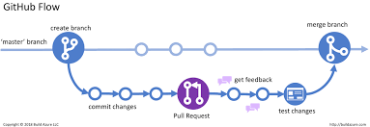
Git & Source Control
An introduction to Git and version control systems

Slide 2
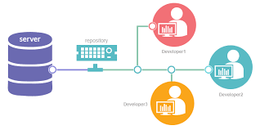
What is Source Control?
Source control, also called version control, is a system that helps developers track and manage changes to their code or files over time.

Slide 3
Use of version control
  Tracks changes: Every modification to your code is recorded, so you can go back to previous versions if needed.
  Collaboration: Multiple developers can work on the same project simultaneously without overwriting each other’s work.
  Branching & Merging: You can create separate “branches” to try new features, then merge them back when ready.

Slide 4
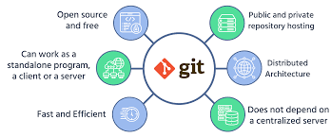
Introduction to Git
Git is a distributed version control system used to track changes in source code.
Created in 2005 by Linus Torvalds for Linux kernel development.

Slide 5
Why Use Git?
Collaboration
Backup & recovery
Branching & merging
Rollback
History tracking

Slide 6
Key Features of Git
Distributed VCS – Every user has a full copy of the repository for independent work.
Fast performance – Git operates quickly, even with large projects.
Strong branching & merging – Easily create, switch, and combine branches without conflicts.
High security – Data is safely stored and changes are tracked with integrity.
Open source – Free to use, modify, and share by anyone.

Slide 7
Basic Git Terminologies
Repository – A place where all project files and history are stored.
Commit – A saved snapshot of your changes in the project.
Branch – A separate version of the project to work on new ideas.
Merge – Combining changes from different branches into one
.
Remote – An online version of the repository shared with others.

Slide 8
Common Git Commands
git init
Initializes a new Git repository in the current folder.
It starts tracking changes in that project.
git clone
Creates a copy of an existing remote repository (for example, from GitHub) on your local system.
git status
Shows the current state of the working directory.
It tells you which files are modified, staged, or untracked.
git add
Adds files to the staging area.
This prepares the files to be included in the next commit.
git commit
Saves the staged changes to the repository with a message describing what was changed.
git pull
Fetches changes from the remote repository and merges them into your local branch.
git push
Uploads your local commits to the remote repository so others can see them.

Slide 9
Git Workflow
Create repository → Clone → Modify → Stage → Commit → Push
Create Repository – Make a new project repo.
Clone – Copy it to your local system.
Modify – Change or add files.
Stage – Prepare files for commit (git add).
Commit – Save changes locally with a message.
Push – Upload changes to the remote repo.

Slide 10
Git Branching
Git Branching allows you to create separate versions of your project to work on new features or fixes without affecting the main code.
It makes experimenting, developing, and collaborating easier by keeping changes isolated until ready to merge.

Slide 11
Git vs GitHub
Git is a powerful version control system that helps developers track and manage changes in their code efficiently.
GitHub is an online platform that hosts Git repositories, making it easy to collaborate with others, share projects, review code, and manage development workflows seamlessly. It combines version control with social coding features for teams and open-source projects.

Slide 12
Applications of Git
Software development
Data Science projects
Open-source collaboration
Enterprise systems

Slide 13
Conclusion
Git and source control improve collaboration, productivity, and code quality.

